Slide 1
SELLING YOUR HOME
THINGS TO CONSIDER WHEN
SPRING 2021
EDITION

Slide 2
TABLE OF CONTENTS
3
5
6
8
10
11
13
14
16
17
18
19
Why You Shouldn’t Wait to Sell Your House
Expert Insights on the Current Housing Market
How Low Inventory Is a Win for Sellers
What Does 2021 Have in Store for Home Prices?
Leveraging Your Equity to Make a Move
Why People Are Moving This Season
Should I Renovate My House Before I Sell It?
If I Sell Now, Where Will I Go?
It Pays to Sell with a Real Estate Agent
Selling Your House with Today’s Technology
Why Pricing Your House Right Matters
Reasons to Hire a Real Estate Professional
2

Slide 3
Why You Shouldn’t Wait to Sell Your House
Selling your house when the fewest number of homes are available to buy is what puts you in the driver’s seat. With today’s high buyer traffic and low inventory of houses for sale, this power combination makes now the optimal time to sell, if you’re ready. Whether you want to move-up or downsize, here’s the breakdown on supply and demand and why this imbalance in the current housing market positions this season as the optimal time to make your next move.
High Buyer Demand
Buyer demand is strong right now, and buyers are active in the market. ShowingTime, which tracks the average number of buyer showings on residential properties, recently announced that buyer showings are up 51.5% compared to the same time last year. Daniil Cherkasskiy, Chief Analytics Officer at ShowingTime, notes:
“As anticipated, demand for real estate remains elevated and continues to be affected by low levels of inventory…On average, each home is getting 50 percent or more requests this year compared to January of last year. As we head into the busy season, it’s likely we’ll push into even more extreme territory until the supply starts catching up with demand.”
Low Inventory of Houses for Sale
Purchaser demand is so high, the market is running out of available homes for sale. Recently, realtor.com reported:
“Nationally, the inventory of homes for sale in January decreased by 42.6% over the past year, a higher rate of decline compared to the 39.6% drop in December. This amounted to 443,000 fewer homes for sale compared to January of last year.”
3
Notes:
https://www.showingtime.com/blog/january-2021-showing-index-results/
https://www.realtor.com/research/january-2021-data/

Slide 4
The National Association of Realtors (NAR) also reveals that, while home sales are skyrocketing, the inventory of existing homes for sale is continuing to drop dramatically. Homes are essentially selling as fast as they’re hitting the market. Below is a graph of the existing inventory for sale:
At the same time, homebuilders are increasing construction this year, but they can’t keep up with the growing demand. While reporting on inventory of newly constructed homes, the U.S. Census Bureau notes:
“The seasonally-adjusted estimate of new houses for sale at the end of December was 302,000. This represents a supply of 4.3 months at the current sales rate.”
What Does This Mean for You?
If you’re thinking of putting your house on the market, don’t wait. A seller will always negotiate the best deal when demand is high and supply is low. That’s exactly what’s happening in the real estate market today.
As 2021 progresses and the pandemic hopefully falls behind us, there will be more houses coming to the market. This includes existing homes and newly built homes. Don’t wait for that increase in competition in your neighborhood. Now is the time to sell.
Bottom Line
Let’s connect today to get your house listed at this optimal time to make a move.
Inventory Level
Existing Homes for Sale
NAR
4
Notes:
https://www.nar.realtor/research-and-statistics/housing-statistics/existing-home-sales
https://www.census.gov/construction/nrs/pdf/newressales.pdf

Slide 5
Expert Insights on the Current Housing Market
In 2020, the housing market surged with activity. Today, real estate experts project that strength to continue through 2021. As Lawrence Yun, Chief Economist for the National Association of Realtors (NAR), notes:
“The housing market was a spectacular surprise in 2020—and the positive trend will continue this year. Home sales in 2021 are expected to rise by around 10%. Home prices will also climb, but I expect more moderate increases than we’ve seen, a break for first-time buyers. Mortgage rates will continue to be favorable, staying at or near historic lows of 3% on average. The labor market will strengthen, especially as vaccines become widely available and life moves toward normal.”
While today’s historically low mortgage rates are expected to remain relatively low, they are forecast to rise going into next year. This means 2021 could be the best chance for homebuyers to secure such a low rate. In a recent article, Freddie Mac explains:
“The average 30-year fixed-rate mortgage is expected to be 2.9 percent in 2021 and 3.2 percent in 2022.”
As long as we continue to see low mortgage rates this spring, we’ll see hopeful buyers on the hunt for their dream homes. Mark Fleming, Chief Economist at First American, confirms:
“By any historic standard, today’s mortgage rates remain historically low and will continue to boost house-buying power and keep purchase demand robust.”
The challenge, however, is the lack of homes available for sale. With that in mind, all eyes are on homeowners to see if they’ll sell this spring or continue waiting. Ali Wolf, Chief Economist at Zonda, explains:
“Some people will feel comfortable listing their home during the first half of 2021. Others will want to wait until the vaccines are widely distributed.”
With buyers staying active this spring, sellers who want to close a deal on the best possible terms shouldn’t wait to put their houses on the market.
Bottom Line
Experts agree, the spring housing market could potentially be bigger than ever. Let’s connect today so you can get in on the action and move into your dream home this year.
5
Notes:
https://magazine.realtor/news-and-commentary/economy/article/2021/01/real-estate-in-2021-plenty-of-reason-for-optimism
http://www.freddiemac.com/fmac-resources/research/pdf/Jan2021_Forecast_Press_Release.pdf
ttps://blog.firstam.com/economics/why-the-housing-market-can-thrive-if-a-new-rising-rate-era-begins
https://www.realtor.com/news/trends/vaccines-housing-market/

Slide 6
How Low Inventory Is a Win for Sellers
Real estate continues to be called the ‘bright spot’ in the current economy, but as we’ve established, there’s one thing that may hold the housing market back from achieving its full potential this year: the lack of homes for sale.
The National Association of Realtors (NAR) explains:
“Total housing inventory at the end of January amounted to 1.04 million units, down 1.9% from December and down 25.7% from one year ago (1.40 million). Unsold inventory sits at a 1.9-month supply at the current sales pace, equal to December's supply and down from the 3.1-month amount recorded in January 2020. NAR first began tracking the single-family home supply in 1982.”
According to NAR, right now, unsold inventory sits at a 1.9-months’ supply at the current sales pace. To have a balanced market in which there are enough homes for sale to meet buyer demand, the market needs 6 months of inventory. Today, we’re nowhere near that number. If this trend continues, it will get even harder to find homes to purchase, and that may slow down potential buyers. Danielle Hale, Chief Economist for realtor.com, notes:
“With buyers active in the market and seller participation lagging, homes are selling quickly and the total number available for sale at any point in time continues to drop lower.”
6
Notes:
https://www.nar.realtor/blogs/economists-outlook/inventory-and-months-supply
https://www.nar.realtor/research-and-statistics/housing-statistics/existing-home-sales
https://www.realtor.com/research/weekly-housing-trends-view-data-week-jan-30-2021/

Slide 7
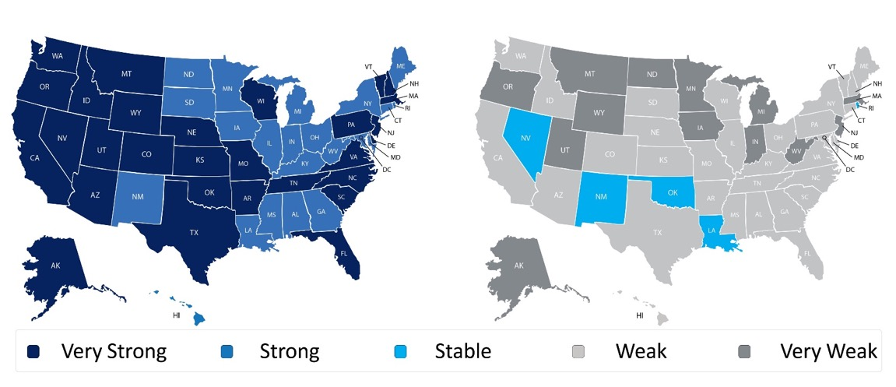
When looking at the maps from the NAR Realtors Confidence Index Survey, it’s clear to see that strong buyer traffic far outpaces weaker seller activity.
In essence, many more people are interested in buying than selling, making it hard for buyers to find a home. When this happens, sellers have the upper-hand in the negotiation.
Realtors are reporting an average of 3.7 offers per house and an increase in bidding wars, meaning the demand is there and now is the perfect time to sell for the most favorable terms.
Bottom Line
If you’re considering selling your house, this is the ideal moment to discuss how you can benefit from the market trends in our local area with a move this spring.
Buyer Traffic Index
Seller Traffic Index
7
Notes:
https://cdn.nar.realtor/sites/default/files/documents/2021-01-realtors-confidence-index-02-19-2021.pdf

Slide 8
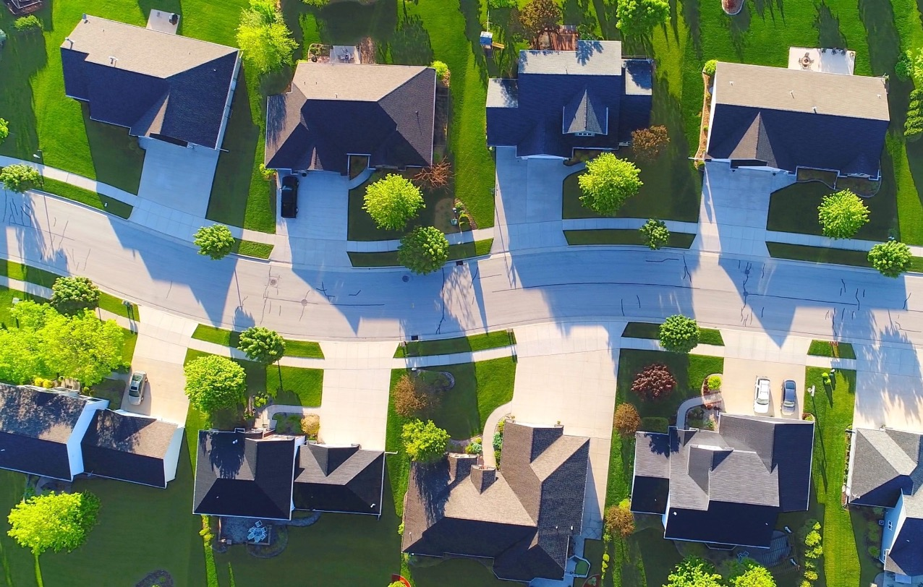
What Does 2021 Have in Store for Home Prices?
According to the latest CoreLogic Home Price Insights Report, nationwide, home values increased by 10% over the last twelve months. The dramatic rise happened when the inventory of houses for sale reached historic lows at the same time buyer demand skyrocketed as a result of record-low mortgage rates.
Where will home values go in 2021?
Home price appreciation in 2021 will continue to be determined by an imbalance of supply and demand. If supply remains low and demand is high, prices will continue to increase, making it a great time to sell your house.
Housing Supply
According to realtor.com, we are entering 2021 with approximately 443,000 fewer homes for sale than there were one year ago.
However, there’s some speculation that the inventory crush will ease somewhat as we move through the new year for two reasons:
1. As the health crisis subsides, more homeowners will be comfortable putting their houses on the market.
2. Some households impacted financially by the pandemic will be forced to sell.
8
Notes:
https://www.corelogic.com/insights-download/home-price-index.aspx
https://www.realtor.com/research/january-2021-data/

Slide 9
Housing Demand
In addition, low mortgage rates have driven buyer demand over the last twelve months. According to Freddie Mac, rates stood at 3.72% at the beginning of 2020. We started 2021 with rates one full percentage point lower than that. Low rates create a great opportunity for homebuyers, which is one reason why demand is expected to remain high throughout the year.
Taking into consideration the projections on housing supply and demand, real estate analysts forecast homes will continue to appreciate in 2021, but that appreciation may be at a steadier pace than last year. Here are their forecasts:
Bottom Line
There’s still a very limited number of homes for sale compared to the demand from purchasers looking to buy them. As a result, home values will continue to appreciate, making this season a pivotal time to sell your house.
2021 Home Price Forecasts
5.9% Average of all Forecasts
9
Notes:
http://www.freddiemac.com/pmms/archive.html
https://cdn.nar.realtor/sites/default/files/documents/forecast-Q1-2021-us-economic-outlook-01-30-2021.pdf
https://www.zelmanassociates.com/ (suscription required)
https://www.realtor.com/research/2021-national-housing-forecast/
http://www.freddiemac.com/research/forecast/20210114_quarterly_economic_forecast.page?
https://www.mba.org/news-research-and-resources/research-and-economics/forecasts-and-commentary
https://www.fanniemae.com/media/37951/display
https://www.corelogic.com/insights-download/home-price-index.aspx

Slide 10
Leveraging Your Equity to Make a Move
According to the latest data from CoreLogic, as of the third quarter of 2020, the average homeowner gained $17,000 in equity over the past year, and that number continues to grow as home values appreciate.
The graph below is a great example of how home price appreciation can work in your favor. If you purchased a $300,000 home in January of this year, based on projected home price appreciation, you would potentially gain an expected $54,221 in equity over the next 5 years – just by being a homeowner.
So, if you’re thinking of moving, remember that as a homeowner, you may have more equity in your house than you realize. Using it to make a move to a new home while interest rates are still low may be the best decision you could make.
Mark Fleming, Chief Economist at First American, notes:
“As homeowners gain equity in their homes, they are more likely to consider using that equity to purchase a larger or more attractive home – the wealth effect of rising equity. In today’s housing market, fast rising demand against the limited supply of homes for sale has resulted in continued house price appreciation.”
Bottom Line
Whether you’re ready to move up into a larger home or downsize into a smaller one, let’s connect to see if your current home equity positions you to make your next move sooner than you may have thought possible.
$54,221
Potential growth in household wealth over the next five years based solely on increased home equity, if you purchased a $300K home in January 2021
Based on price appreciation projected by the Home Price Expectation Survey
Home Price Expectation Survey 2020 4Q
10
Notes:
https://www.realestateconsulting.com
https://www.corelogic.com/insights-download/homeowner-equity-report.aspx
https://blog.firstam.com/economics/housing-market-potential-reaches-highest-level-since-2007

Slide 11
Why People Are Moving This Season
Today, Americans are moving for a variety of reasons. The current health crisis has truly re-shaped our lifestyles and our needs. Spending extra time where we currently live is enabling many people to re-evaluate what homeownership means and what they find most important in a home.
According to the 2020 Annual National Movers Study:
“For customers who cited COVID-19 as an influence on their move in 2020, the top reasons associated with COVID-19 were concerns for personal and family health and wellbeing (60%); desires to be closer to family (59%); 57% moved due to changes in employment status or work arrangement (including the ability to work remotely); and 53% desired a lifestyle change or improvement of quality of life.”
With a new perspective on homeownership, here are some of the top reasons people are reconsidering where they live and making moves this season.
1. Working from Home
Remote work is the new norm, and it’s continuing on longer than most initially expected. Many in the workforce today are discovering they don’t need to live so close to the office anymore and they can get more for their money if they move a little further outside the city limits. Freddie Mac notes:
“The demand for housing is expected to remain strong in the new year, fueled by both low mortgage rates and the ability to work remotely. Last year, home sales reached highs not seen since 2006 and we expect sales to ride that wave into 2021, averaging 6.5 million for the year.”
If you’ve tried to convert your guest room or your dining room into a home office with minimal success, it may be time to find a larger home. The reality is, your current house may not be optimally designed for this kind of space, making remote work very challenging.
11
Notes:
https://www.unitedvanlines.com/newsroom/movers-study-2020
http://www.freddiemac.com/blog/research_and_analysis/20210125_what_will_2021_bring_for_housing.page?

Slide 12
2. Virtual and Hybrid Schooling
Many school districts are using a model of virtual or hybrid learning, turning their curriculums into digital formats for students. If you have school-age children, they may have a need for a dedicated learning space. If so, it might be time to find a larger home to provide your children with the same kind of quiet room to focus on their schoolwork, just like you probably need for your home office work too.
3. A Home Gym
Staying healthy and active is a top priority for many Americans. With various levels of concern around the safety of returning to fitness facilities across the country, dreams of space for a home gym are growing stronger. The Home Builders Association of Greater New Orleans explains:
“For many in quarantine, a significant decrease in activity is more than a vanity issue – it’s a mental health issue.”
Having room to maintain a healthy lifestyle at home – mentally and physically – may prompt you to consider a new place to live that includes space for at-home workouts.
4. Outdoor Space
In a survey of current homeowners, Porch highlights the desire many people now have for more usable exterior features as well:
You may, however, not have the extra square footage in your home today to have these designated areas – inside or out.
Moving May Be Your Best Option
If you’re clamoring for more room to accommodate your changing needs, making a move may be your best bet, especially while you can take advantage of today’s low mortgage rates. It’s a great time to get more home for your money, just when you need it most.
Bottom Line
Today, Americans are moving for a variety of reasons, and many peoples’ needs have changed. If you’ve been trying to decide if now is the time to upgrade your home, let’s connect to discuss your options and your goals.
12
Notes:
https://www.hbagno.org/news/details/8-features-home-buyers-want-after-covid-19
https://porch.com/resource/the-great-outdoors

Slide 13
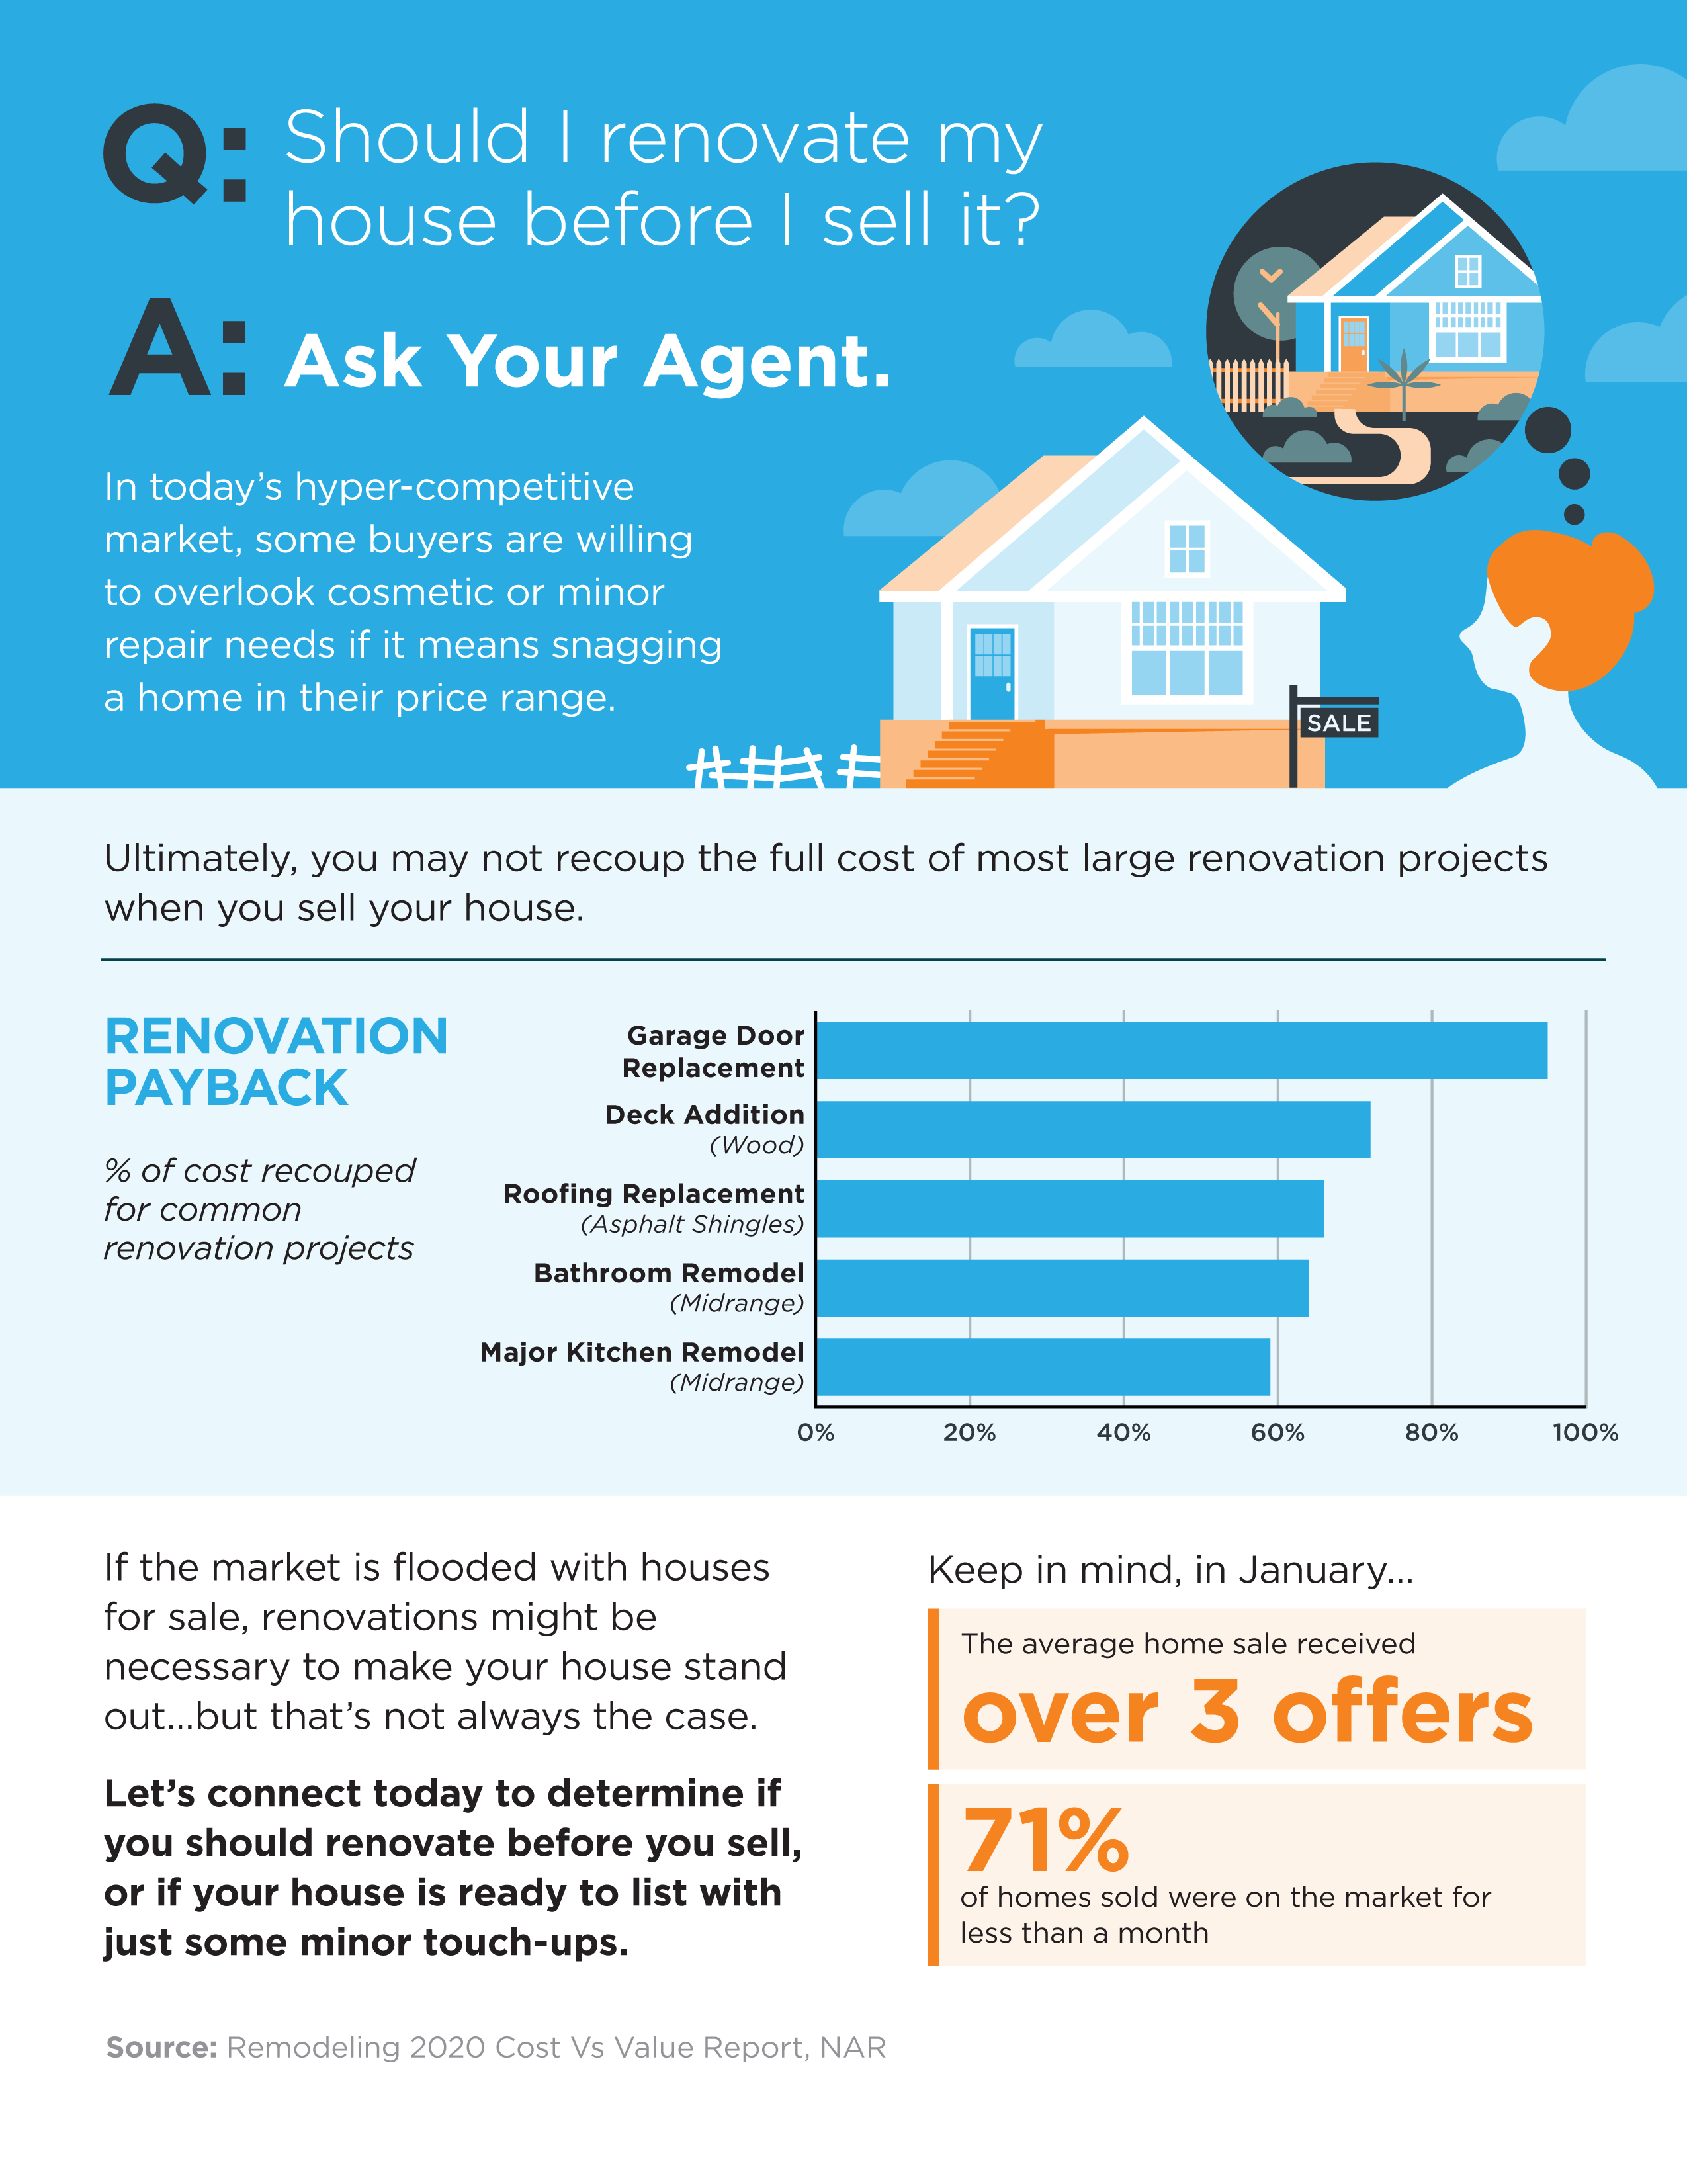
13
Notes:
https://www.metrostudy.com/press/remodeling-magazine-releases-2019-cost-vs-value-report/
https://cdn.nar.realtor/sites/default/files/documents/2021-01-realtors-confidence-index-02-19-2021.pdf
https://www.nar.realtor/newsroom/existing-home-sales-tick-up-0-6-in-january

Slide 14
If I Sell Now, Where Will I Go?
Now is clearly a great time to sell, but when you do, how will you find a new home to move into while inventory is so low? With so few homes for sale and construction of newly built homes ramping up, you may be wondering if you should consider new construction in your search process. It’s a great question to ask, and one to look at from the pros and cons of what it means to buy a new home versus an existing one. Here are a few things to consider when making your decision, while always remembering to work with your trusted real estate professional along the way.
Purchasing a Newly Built Home
When buying a new home, you can often choose more energy-efficient options. New appliances, new windows, a new roof, etc. These can all help lower your energy costs, which can add up to significant savings over time. With programs like ENERGY STAR, a new home also helps protect the environment and reduces your carbon footprint.
Lower maintenance that comes with a newer home is another great benefit. When you have a new home, you likely won’t have as many little repairs to tackle, like leaky faucets, shutters to paint, and other odd jobs around the house. With new construction, you’ll also have warranty options that may cover portions of your investment for the first few years.
Another solid benefit to new construction is customization. Do you want a mudroom, stainless steel appliances, granite countertops, hardwood floors, an office, or a multi-purpose room? These items can be customized to your specific needs during the design phase. With an existing home, you’re buying something that’s already completed, so if you want to make changes, you may need to hire a contractor to help get your home ready.
14
Notes:
https://www.energy.gov/eere/buildings/energy-star

Slide 15
Buying an Existing Home
When buying an existing home (one that’s already been built), you can negotiate with the current homeowner on price, which is something you generally don’t get to do with a builder. Builders know their material and construction costs, and they have a price set for the model you’re buying. So, if you want to negotiate, an existing home is likely your best option.
For some buyers, moving into an established neighborhood may be important. If you’d like to get a better sense of things like general traffic patterns in the area and the feel of the community before making a commitment, you might prefer an existing home. When you buy new construction, you won’t always have a full view into some of these details until the lots around you are sold.
Finally, timing comes into play. With an existing home, you can move in based on the timeline you agree to with the sellers, rather than waiting for the house to be built. Depending on the time of the year you’re buying and the region you’re in, the weather can also be a factor in the timeframe. This is something to keep in mind, especially if you need to move sooner rather than later. With COVID-19 and social distancing regulations, some areas for new construction have been on a delay.
Bottom Line
Whether you want to buy a newly built home or one that’s already established, both are great options. They each have their pros and cons, and every buyer will have different circumstances driving their decision. If you have questions and want to know more about the options in our area, let’s work together so you can feel confident about your next home.
15
Notes:
https://www.cdc.gov/coronavirus/2019-ncov/community/organizations/construction-workers.html

Slide 16
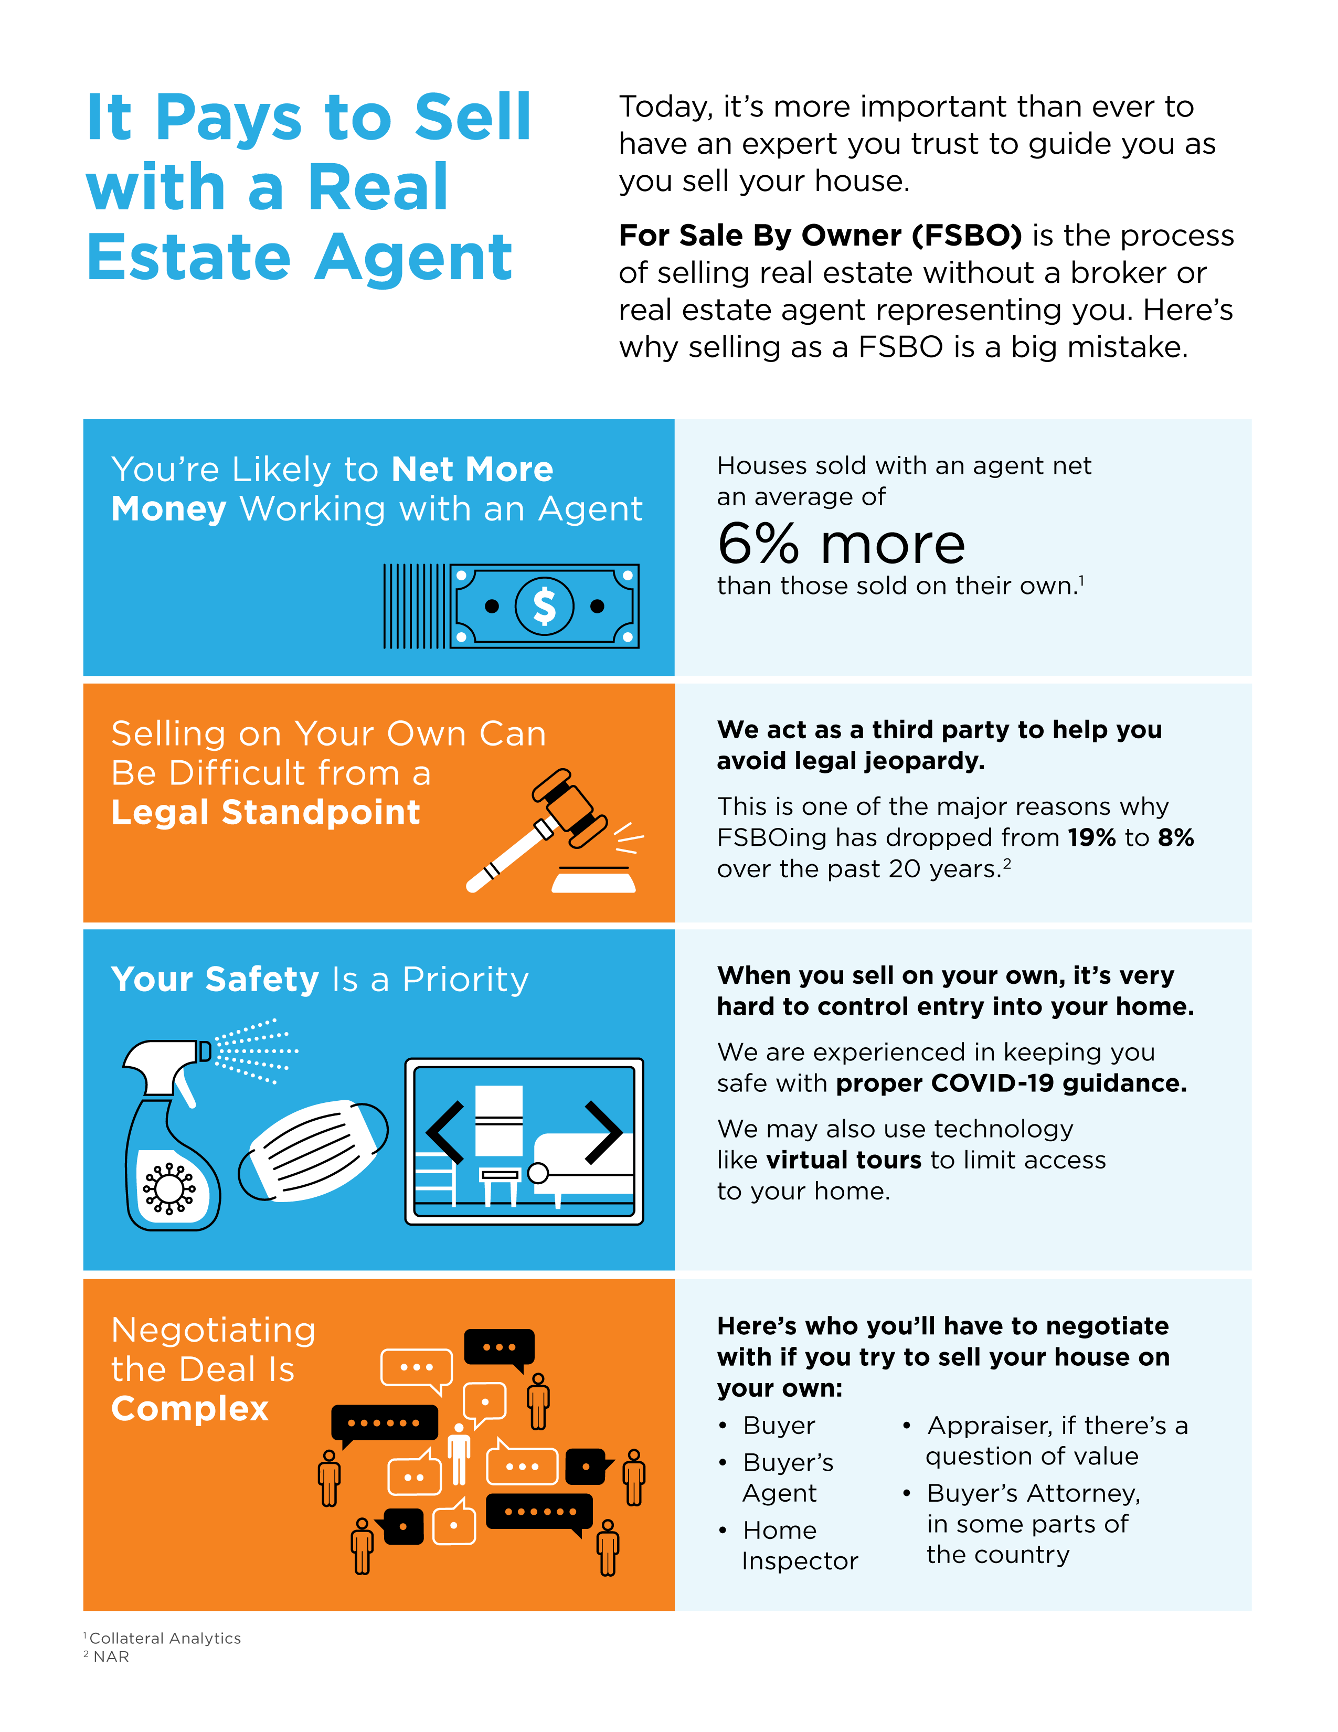
16
Notes:
https://www.nar.realtor/coronavirus-a-guide-for-realtors
https://www.nar.realtor/research-and-statistics/research-reports/home-buyer-and-seller-generational-trends

Slide 17
Selling Your House with Today’s Technology
In a survey by realtor.com, people thinking about selling their houses today indicated they’re generally willing to allow their agent and some potential buyers inside, but only under the right conditions. With the current safety guidelines and technology options recommended by the National Association of Realtors (NAR), real estate agents are well versed in using safe and effective virtual practices and emerging technology throughout the process. So, if you need to sell your house now, what digital options should you use to make sure you and your potential buyers stay safe throughout the process?
Working with a trusted professional who’s skilled with today’s changing virtual practices may help you win big. While always abiding by state and local regulations, agents know exactly what today’s buyers need, and how to put the necessary digital steps in place. For example, according to the same survey, when asked to select the technology that would be most helpful when deciding on a new home, here’s what today’s homebuyers said, in order of preference:
Virtual tour of the home
Accurate and detailed listing information
Detailed neighborhood information
High-quality listing photos
Agent-led video chat
When it’s time to show your house in person, agents are also able to regulate the process, based on the recommendations given by NAR, to help you proceed safely. Here are a few of the guidelines, understanding the top priority should always be to obey state and local restrictions first:
Limit in-person activity
Require guests to wash their hands or use an alcohol-based sanitizer
Remove shoes or cover with booties
Follow CDC guidance on social distancing and wearing face coverings
Bottom Line
In this era of life, things are shifting quickly, so virtual seller strategies may be a game-changing option for you. Let’s connect so you can safely and effectively navigate through all that’s evolving when it comes to making your next move.
17
Notes:
https://www.nar.realtor/infographics/2019-real-estate-in-a-digital-age
https://www.nar.realtor/coronavirus-a-guide-for-realtors%C2%AE
https://news.move.com/2020-04-16-Would-You-Buy-a-Home-Without-Stepping-Foot-Inside

Slide 18
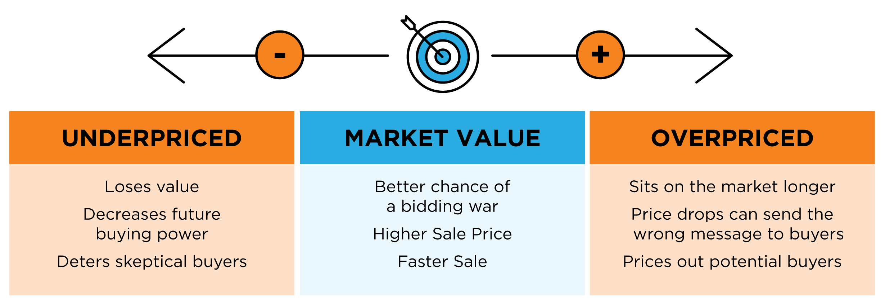
Why Pricing Your House Right Matters
In today’s real estate market, setting the right price for your house is one of the most valuable things you can do. According to CoreLogic, existing home prices nationwide are expected to increase by 3.3% this year. This means experts anticipate home values will continue climbing going forward. When it comes to pricing your house, the goal is to increase visibility and drive more buyers your way. Instead of trying to win the negotiation with one buyer, you should price your house so that demand is maximized, and more buyers want to take a look.
As a seller, you might be thinking about pricing your house on the high end while so many of today’s buyers are searching harder than ever just to find a home to purchase. But here’s the thing – a high price tag does not mean you’re going to cash in big on the sale. It’s actually more likely to deter buyers.
Even today, when there are so few houses for sale, your house is more likely to sit on the market longer or require a price drop that can send buyers running if it isn’t set just right.
It’s important to work with a trusted real estate professional to make sure your house is priced correctly. When you price it competitively, you won’t be negotiating with one buyer. Instead, you’ll have multiple buyers competing for the house, potentially increasing the final sale price.
Bottom Line
The key is to make sure your house is priced to sell immediately. This way, it will be seen by the most buyers. More than one of them may be interested, and it will be more likely to sell at a competitive price. Let's connect to price your house correctly from the start so you can maximize your exposure and your return.
18
Notes:
https://www.nar.realtor/research-and-statistics
https://cdn.nar.realtor/sites/default/files/documents/forecast-Q1-2021-us-economic-outlook-01-30-2021.pdf

Slide 19
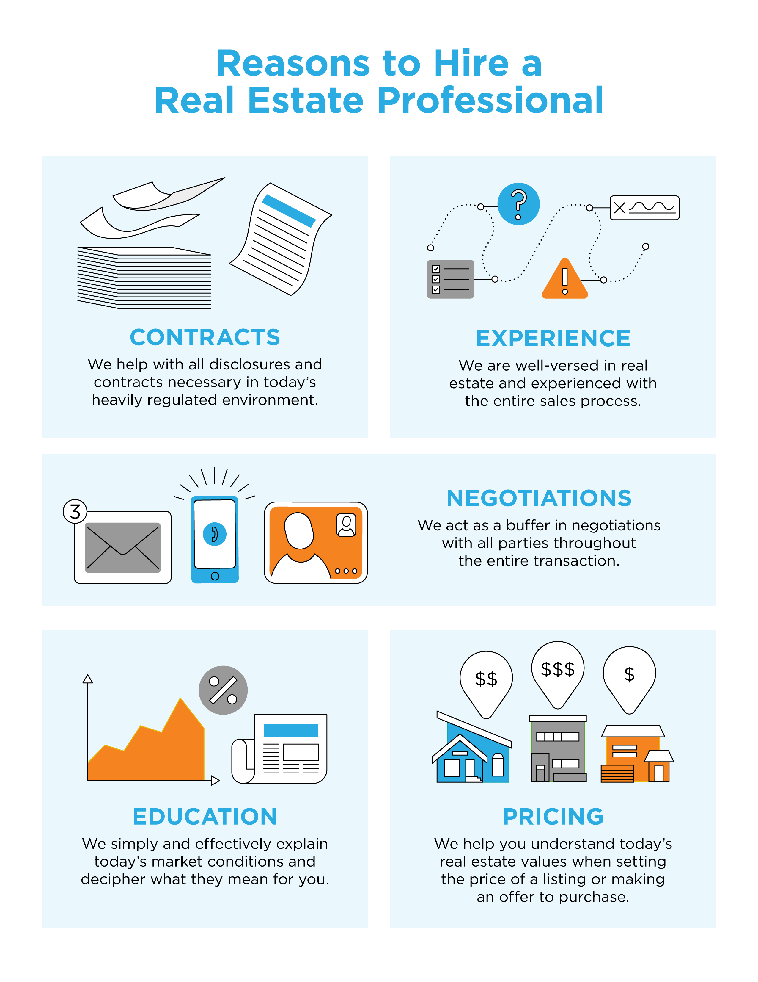
19

Slide 20
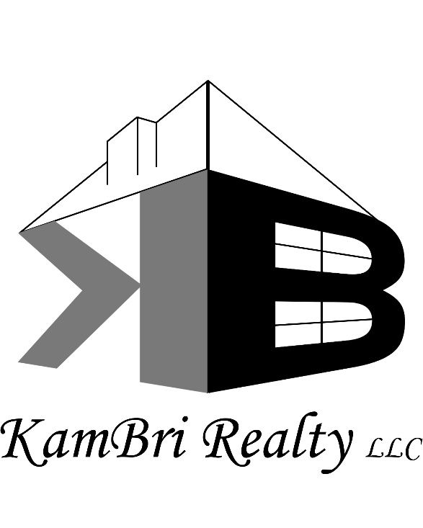
CONTACT ME TO TALK MORE
I’m sure you have questions and concerns about the real estate process.
I’d love to talk with you about what you read here and help you on the path to selling your house. My contact information is below, and I look forward to working with you.
KARYN MURPHY
Owner/Managing Broker
KamBri Realty, LLC
Mokena, IL KarynMurphyKBR.com
(708)278-6996
Equal Housing Opportunity

